Slide 1
Capstone Project Sakila DVD Rental Store
ABHISHEK KUMAR

Slide 2
TABLE OF CONTENTS
01
DESCRIPTIVE ANALYSIS
Objective, scope, goal, insights & recommendations, presentation
02
DATA DICTIONARY & EER DIAGRAM & DATA MODEL
Definitions of key database tables and fields & ER Diagram
03
PROBLEM STATEMENTS - SOLUTIONS
A visual representation of the analysis of Problem Statements with explanation.

Slide 3
Objective: This analysis of the Sakila DVD Rental Store database aims to uncover actionable insights into the rental business's operational aspects and customer dynamics. By examining rental patterns, inventory availability, and rental completion rates, the objective is to provide strategic recommendations for optimizing the store's performance, enhancing customer satisfaction, and fostering growth in a competitive market.
Analysis Scope: This analysis encompasses a comprehensive examination of key database tables and fields within the Sakila DVD Rental Store database, spanning customer information, rental history, inventory management, and more. The scope extends to both Power BI reports and exploratory data analysis (EDA) in Excel to provide a holistic understanding of the dataset.
Goal: The goal of this analysis is to leverage the Sakila DVD Rental Store database to uncover operational insights and customer behavior patterns, empowering data-driven strategies to optimize performance, enhance customer satisfaction, and promote sustainable growth in a competitive market.

Slide 4
Insights and Recommendations: The findings from this analysis shed light on seasonal rental trends, customer behavior, and inventory turnover rates. These insights serve as the foundation for strategic recommendations that include promotional strategies during peak seasons, customer engagement initiatives, and tailored inventory management to maximize revenue and customer satisfaction.
Report and Presentation: The culmination of this analysis is a comprehensive report and presentation that distill the insights, findings, and recommendations into a clear narrative. These deliverables will provide a visual and data-driven understanding of the Sakila DVD Rental Store's operational landscape, offering actionable strategies for growth and improved customer satisfaction.
Importance of Power BI Report and EDA Analysis in Excel: The Power BI report offers dynamic visualizations that enable interactive exploration of data, while EDA analysis in Excel allows for in-depth examination and calculation of key metrics. Together, these tools provide a robust framework for extracting valuable insights, facilitating informed decision-making, and presenting a holistic view of the dataset's nuances. This integrated approach enhances the effectiveness of this analysis in driving actionable recommendations for the Sakila DVD Rental Store database.

Slide 5
METADATA
TABLES
Actor
Address
Category
City
Customer
Film
Film Actor
Film Category
Film Text
Inventory
Language
Payment
Rental
Staff
Store

Slide 6
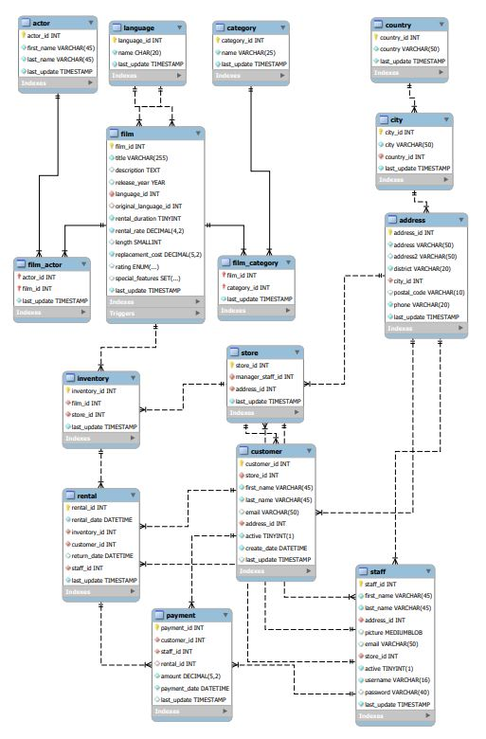
EER DIAGRAM

Slide 7
Power BI - Problem Statements

Slide 8
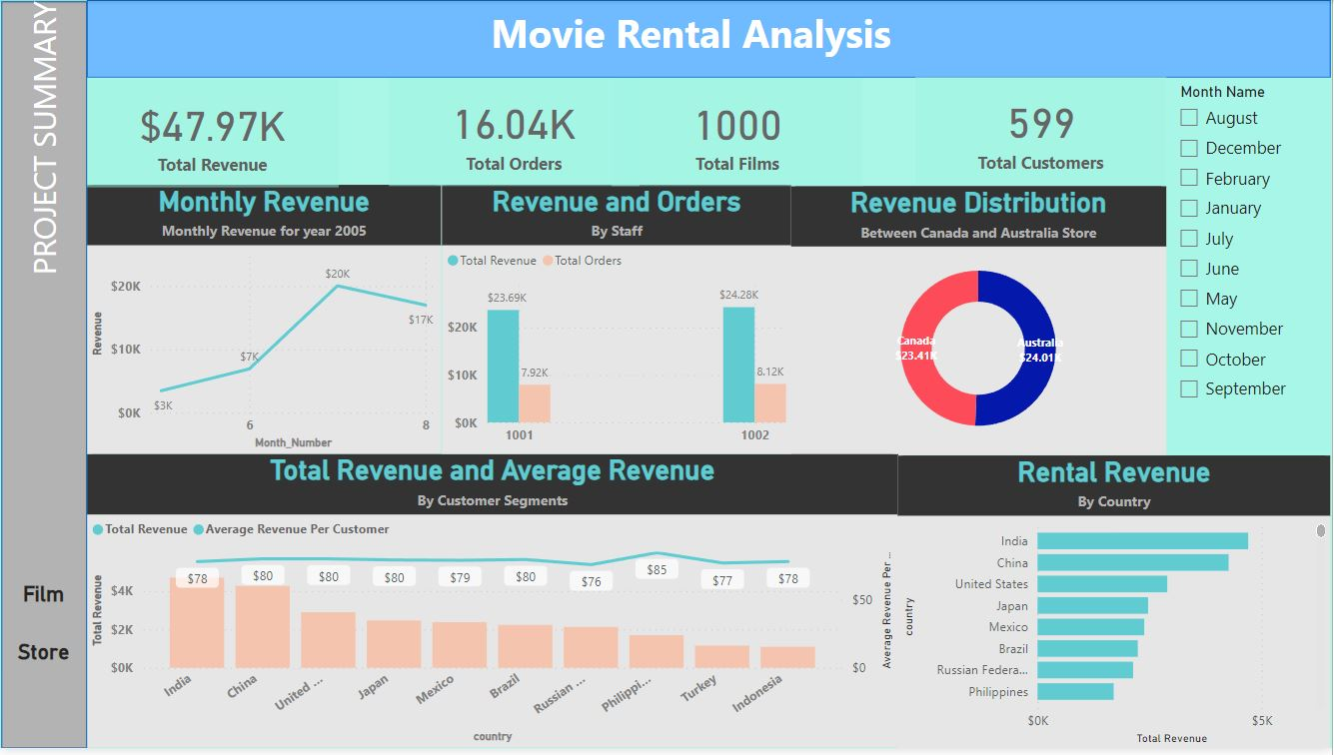

Slide 9
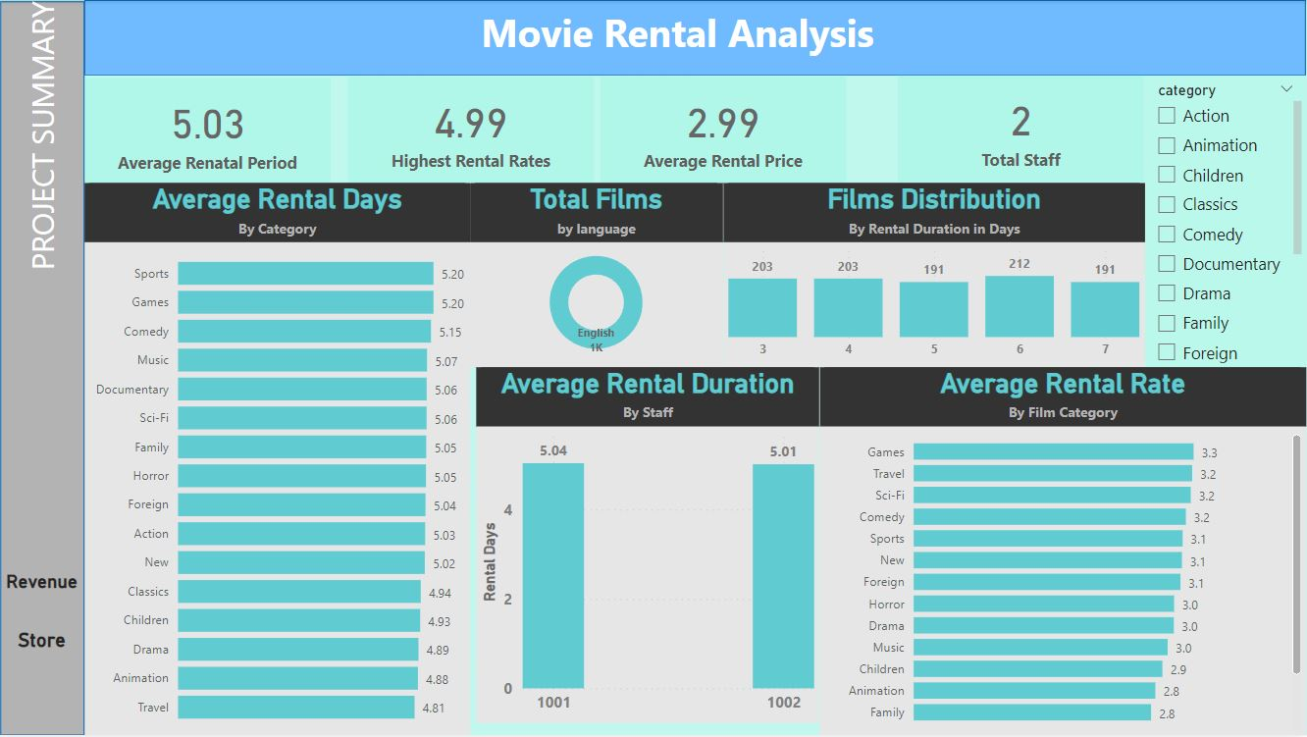

Slide 10
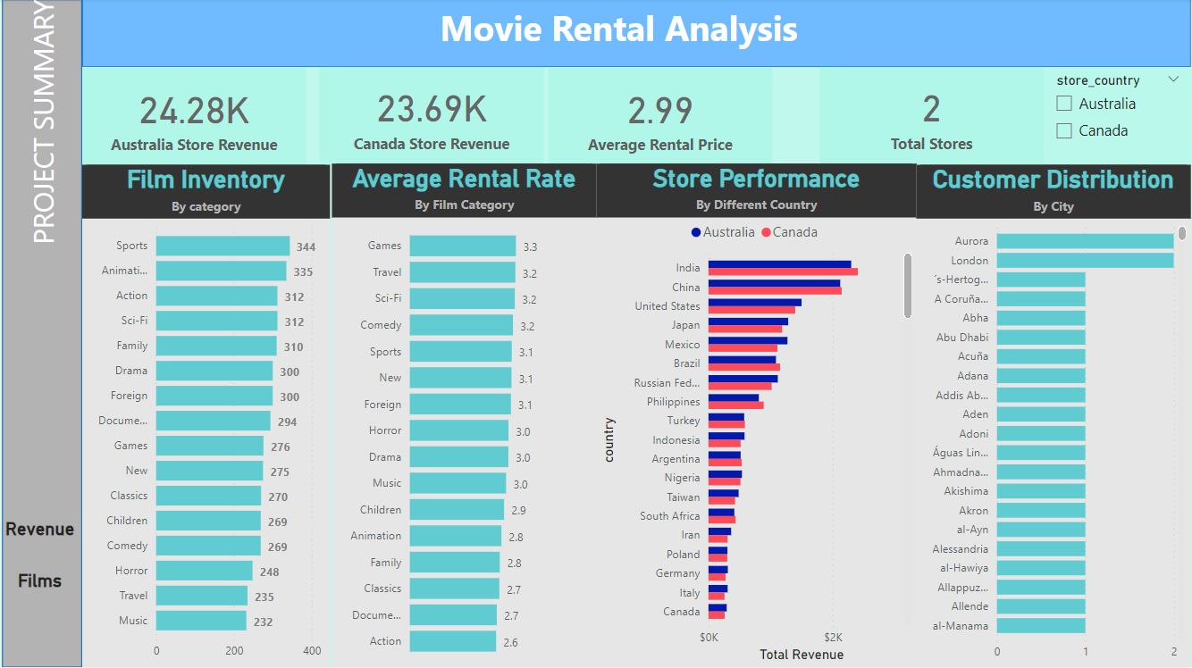

Slide 11
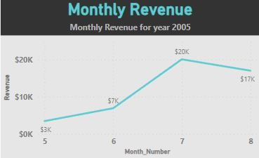
How does the sales revenue vary by month?
The line chart showcases revenue variations across months, with July as the highest revenue month, followed by August, June, May, and February. The stacked bar chart presents rental ID and customer counts per month, highlighting July as the peak month for both revenue and rental volume. This analysis informs strategies to capitalize on peak periods, engage customers effectively, and support continued growth.

Slide 12
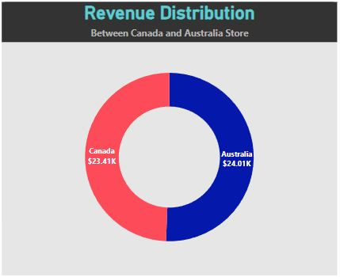
What is the distribution of sales by store?
The line chart tracks payment counts from July 2005 to January 2006, highlighting variations in sales. The peak of 679 payments on July 31, 2005, signifies high sales, while the low of 23 payments on August 16, 2005, reflects slower sales. Further analysis can confirm any seasonal trends, making this data valuable for inventory management and business strategy optimization.

Slide 13
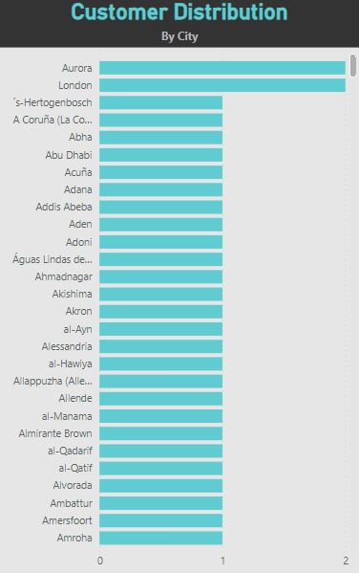
What is the distribution of customers across different cities?
The clustered bar chart in the Rental Analysis Dashboard reveals that two cities, Aurora and London, have two customers each, while the majority of cities, 601 out of 603, have only one customer. This indicates the need for targeted marketing in cities with higher customer concentration, optimized inventory allocation to serve a geographically diverse customer base, potential customer expansion in cities with single customers, and dedicated customer retention efforts in cities with multiple customers, all contributing to enhanced business strategies.

Slide 14
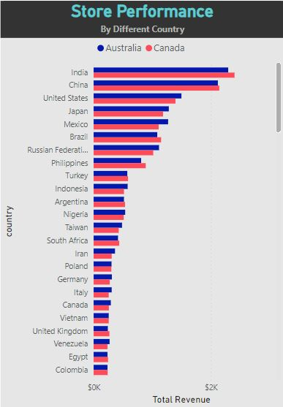
Which customer segments generate the highest sales?
This chart indicates that countries like India, China, the US, Japan, and Mexico boast substantial customer bases, contributing significantly to overall sales. On the other hand, nations like Nepal and Turkmenistan, although fewer in customer count, exhibit higher average rental amounts. This presents an opportunity to enhance revenue per customer by attracting more customers from these countries. Simultaneously, retaining and engaging customers in high-count countries like India and China can bolster overall sales.

Slide 15
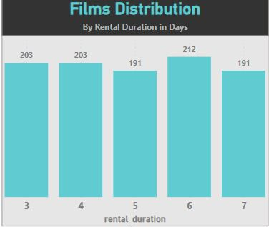
What is the distribution of films by rental duration?
This analysis highlights that films with a rental duration of 6 days are the most prevalent, encompassing 212 films in the inventory. Interestingly, films with rental durations of 3, 4, 5, and 7 days are also well-represented, each featuring 203 to 191 films. This diversity suggests a wide array of options to cater to varied customer preferences. With a total of 1000 films available, effective inventory management becomes pivotal. Ensuring an ample stock of films aligning with the most common 6-day rental duration can help prevent stockouts, while personalized marketing and pricing strategies based on customer rental preferences can further enhance the overall customer experience.

Slide 16
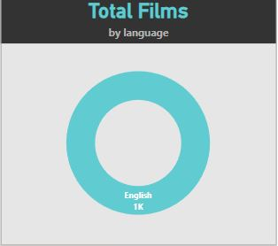
What is the distribution of films by language?
The utilization of a donut chart effectively communicates that all films within the Sakila DVD Rental Store Database are exclusively in the English language. The absence of any segments other than English underscores the lack of linguistic diversity in the film offerings. This limitation may potentially restrict market access to non-English-speaking customers, highlighting an opportunity for market expansion through diversification. By introducing films in languages like Italian, Japanese, Mandarin, French, and German, the store can access new markets, increase customer engagement, gain a competitive edge, and unlock revenue potential.

Slide 17
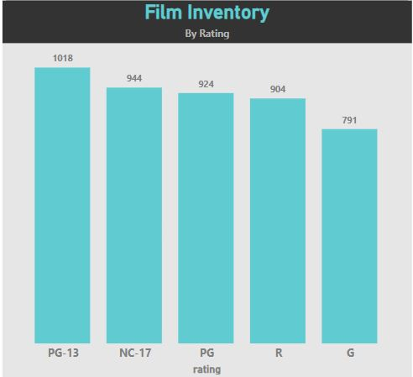
How does the inventory vary by film rating?
This analysis employs two visualizations: a clustered bar chart and a matrix. The clustered bar chart offers a quick overview of inventory distribution across different film ratings, with "PG-13" holding the highest inventory count at 1,018 items. The matrix provides a detailed breakdown of film and inventory counts by rating. Findings show that "PG-13" and "NC-17" films have substantial inventory presence, while "G" ratings have the lowest inventory count. To optimize inventory management, it is recommended to adjust stock levels based on customer preferences, and targeted marketing for high-inventory rating categories like "PG-13" and "NC-17" can help enhance customer satisfaction and drive growth.

Slide 18
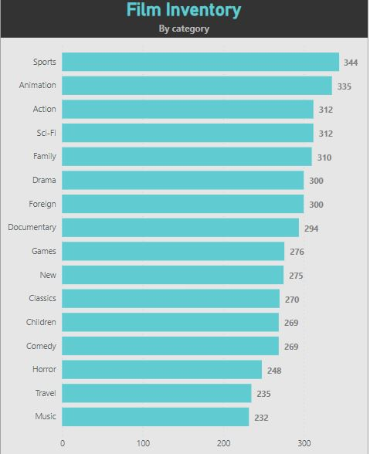
What is the breakdown of film categories in the inventory?
This analysis employs a Bar plot visualization to portray the distribution of inventory items by film category. The chart indicates that Sports, Animation, Action, and Sci-Fi film categories have the highest inventory counts, while Children, Comedy, Horror, Travel, and Music categories have relatively lower inventory counts. To optimize inventory management, it is suggested to adjust procurement and restocking strategies based on category popularity, ensuring a consistent supply for highly popular categories and optimizing inventory levels for less popular ones. Tailoring marketing campaigns and promotions to engage customers in specific categories can also enhance customer satisfaction and drive rentals.

Slide 19
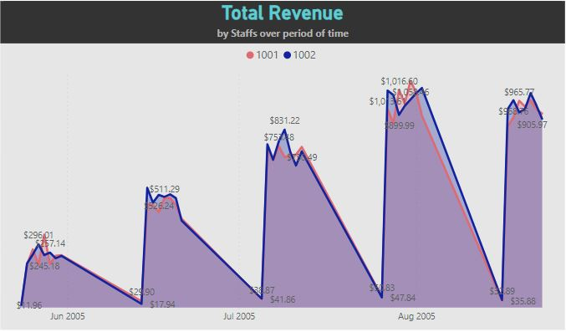
What is the revenue generated by both staffs over time?
The area chart illustrates the total rental payment amounts generated by both staff members over time, segmented by day, month, quarter, and year. It reveals fluctuations in payment trends and identifies peak periods in specific quarters and months. Staff id 1002 appears to generate slightly higher rental payment amounts than Staff id 1001. Monitoring these trends allows for optimized staffing and resource allocation during peak rental periods, ensuring efficient operations and customer satisfaction. These visualizations provide actionable insights into staff performance, customer engagement, and payment trends, offering opportunities for staff management and resource allocation optimization.

Slide 20
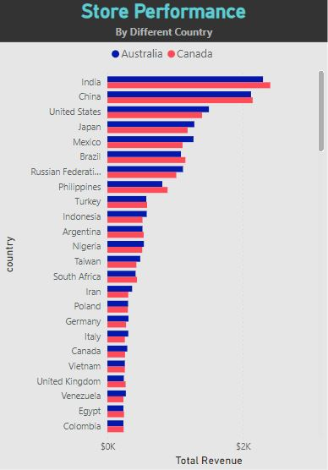
How does the store performance vary by location?
The Clustered Bar Chart efficiently visualizes total sales revenue generated by Canada Store and Australia Store across various countries. Notably, India, China, the United States, Japan, and Mexico emerge as significant contributors to the stores' revenue. India leads in revenue, reflecting its vital role in the stores' financial success. However, it's important to recognize that variations in rental count and revenue suggest potential differences in transaction values or pricing strategies among countries.

Slide 21
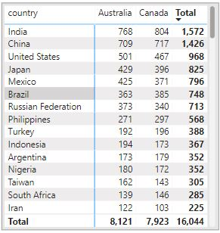
How does the store performance vary by location based upon total orders?
The Matrix provides a detailed overview of rental counts by country for each store. India once again stands out as a top-performing country in terms of rental count. This observation, in conjunction with revenue insights, underscores the complexity of the relationship between rental count and revenue. Pricing models and promotional strategies may need to be adapted to maximize revenue in regions with high rental counts but comparatively lower revenue.

Slide 22
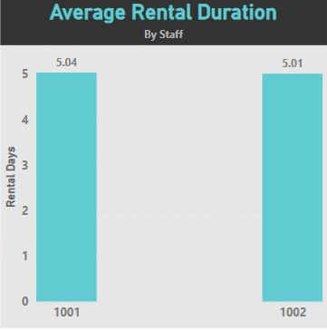
What is the average rental duration by staff member?
The column chart effectively illustrates the average rental duration by staff member (Staff ID 1001 and Staff ID 1002).
staff member 1001 display slightly more average rental durations, but more or less they are identical indicating consistent performance in handling rentals concerning rental duration. This uniformity suggests an opportunity for optimized staff allocation, standardized training programs, and refined performance metrics. Moreover, maintaining consistent rental durations contributes to a uniform customer experience, fostering higher customer satisfaction and loyalty.

Slide 23
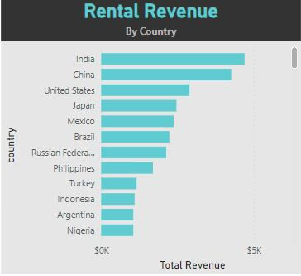
How does the rental revenue vary by country?
The clustered map provides an insightful view of rental revenue distribution by country. Notably, India and China emerge as the primary contributors. This concentration underscores the importance of strategic focus on these markets. The chart also reveals the store's global presence, offering opportunities for expansion and targeted marketing in countries with smaller revenue. Overall, this visualization empowers data-driven decisions for resource allocation, refined marketing, and tailored services based on regional revenue trends.

Slide 24
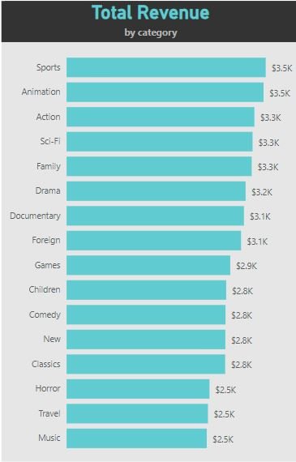
Which film categories have the highest revenue?
The utilization of a Bar chart in the analysis showcases the distribution of revenue across 16 film categories. Notably, the "Sports" and “Animation" category commands the highest revenue $3.5K, closely followed by “Action“ “Sci-Fi”, and “Family” $3.3K.
Conversely, the "Music" category records the lowest revenue $2.5K. This insightful analysis guides inventory prioritization, marketing strategies, and pricing adjustments to optimize rental revenue and customer engagement.

Slide 25
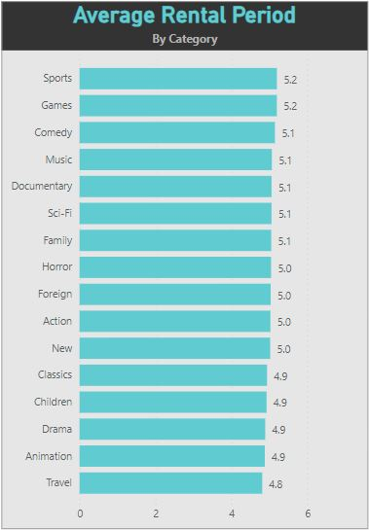
How does the average rental duration vary by film category?
This bar plot effectively visualizes the film categories and their respective average rental durations. Key findings include variations in rental durations, with the “Travel" category having the shortest durations (4.8 days) and “Sports" and “Games" showing longer durations 5.2 days). Most categories indicating similar customer preferences. The implications lie in optimizing inventory, tailoring marketing strategies, and gaining valuable customer insights based on rental behaviours to enhance customer engagement and satisfaction.

Slide 26

Sakila DVD Rental Store Insights and Recommendations
01
Revenue Concentration
03
Language Diversity
05
Pricing Strategies
India and China are top revenue contributors.
Tailor prices to film category demand.
Consistent Customer Experience
04
Inventory Optimization
06
Marketing Focus
02
Maintain uniform
rental durations.
Adjust stock levels based on film ratings.
Promote popular film categories effectively.

